Slide 1
New Regulatory Building Blocks for Payments are planned
David Mangini
david.mangini@gioridigital.com

Slide 2
Introduction
Technology has driven a renewed focus on stablecoins and cross-border payments.
Private digital currencies may also be introduced (Diem).
Regulations will continue to play a major role in payments
The G20 countries have jointly established a work plan to address the many moving parts of the payments space.
Combined effort from the CPMI (Committee on Payment Market Infrastructure) at the BIS and the Financial Stability Board (FSB).

Slide 3
What is the point?
Payment hubs, including Mojaloop, will evolve to cover new use cases, perhaps cross-border, different currencies, and settlement between fiat money and bank/mobile money.
Other systems for “virtual assets” may one-day also be introduced through the payment systems connected to payment hubs and possibly Mojaloop in the future.
International standards for Anti-Money Laundering (AML) and Terrorist Financing (TF) will apply across an expanding range of payment methods, including virtual assets and CBDC.
The Mojaloop scheme may face future requirements to meet an evolving set of regulations to mitigate risks.
Future: Cross-border with the same currency (monetary unions)
Future: Cross-border with different currencies (foreign exchange through settlement)

Slide 4
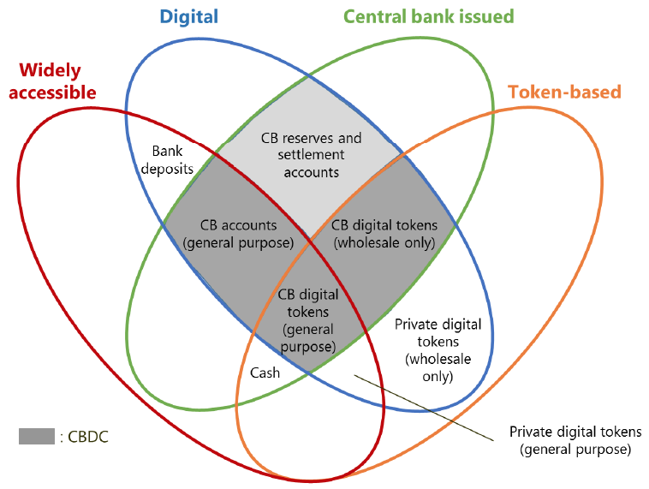
Regulatory Impacts for Digital Payments
Stablecoins:
FATF Report to the G20
Cross-Border:
FSB Report to the G20
CPMI Report to the G20
FSB Report to the G20
Source: BIS CPMI CBDC, March 2018

Slide 5
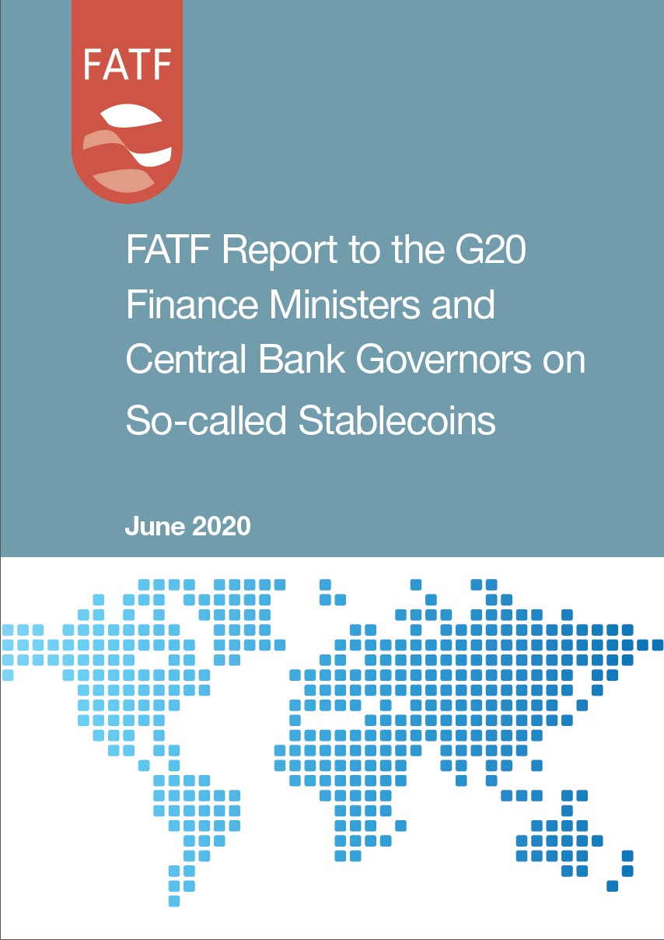
FATF Report to G20 on Stablecoins
In October 2019, the G20 asked the FATF to consider the AML/CFT issues relating to “global stablecoins”.
This report sets out the FATF’s analysis of the AML/CFT issues relating to so-called stablecoins.
The Financial Action Task Force (FATF) is an independent inter-governmental body that develops and promotes policies to protect the global financial system against money laundering, terrorist financing and the financing of proliferation of weapons of mass destruction. https://www.fatf-gafi.org/about/

Slide 6
Contents of the FATF Report
Section 1: Definition of stablecoins
Section 2: ML/TF risks of stablecoins
Section 3: Application of revised FATF Standards
Section 4: Residual ML/TF risks
Section 5: Enhancing global AM/TF framework
Annex A: Recommendation 15 Interpretive Note
Annex B: Central Bank Digital Currencies

Slide 7
Highlights of the FATF Stablecoin report
“The FATF has found that so-called stablecoins share many of the same potential ML/TF risks as some virtual assets, in virtue of their potential for anonymity, global reach and layering of illicit funds.”
“Importantly, central developers and governance bodies of so-called stablecoins will have AML/CFT obligations under the revised FATF Standards, where they are carrying out the activities of a financial institution or VASP {Value Added Service Provider}, in addition to the AML/CFT obligations of other entities with AML/CFT obligations, e.g., wallet providers.”
“The FATF consider that so-called stablecoins with potential for mass-adoption will be centralised to some extent, with an identifiable central developer or governance body. The FATF considers that these developers and governance bodies will be, in general, financial institutions … or a VASP … under the revised FATF Standards.”

Slide 8
FATF position on CBDC Risks
“For FATF’s purposes, CBDCs are not virtual assets.”
“CBDCs could present greater ML/TF risks than cash.”
“The revised FATF Standards however apply to central bank digital currencies similar to any other form of fiat currency issued by a central bank.”
”Therefore, the activities of financial institutions, designated non-financial businesses and professions and VASPs using CBDCs would be covered as if they were using cash or electronic payments.”
“This, for example, could include limiting the ability for anonymous peer-to-peer transactions to occur with the CBDC.”
“A customer transacting using a CBDC will have the same customer due diligence obligations as if it was an electronic transaction using fiat currency.”

Slide 9
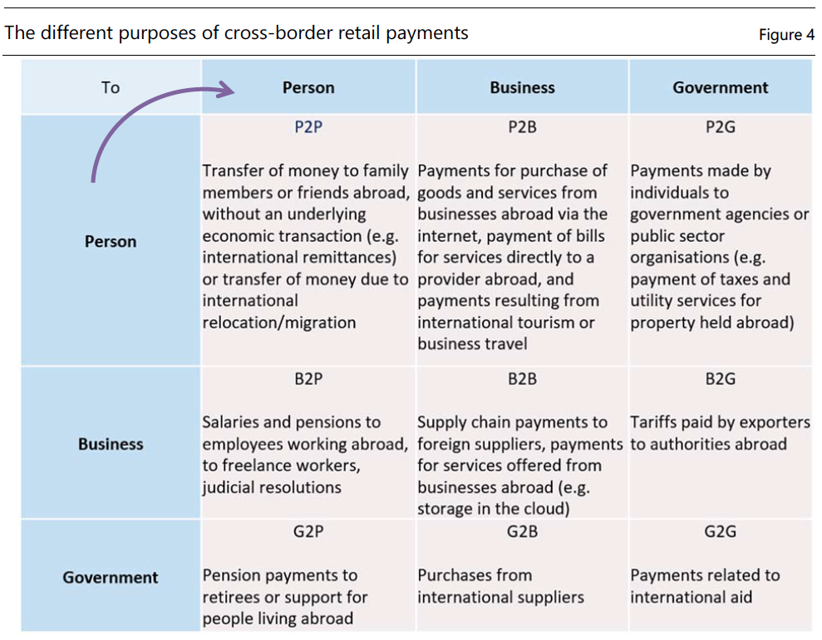
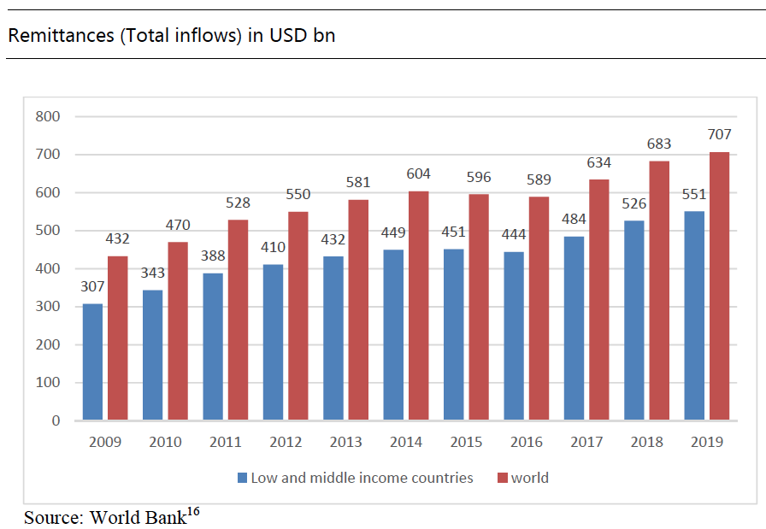
Cross-border payments: Broad use cases

Slide 10
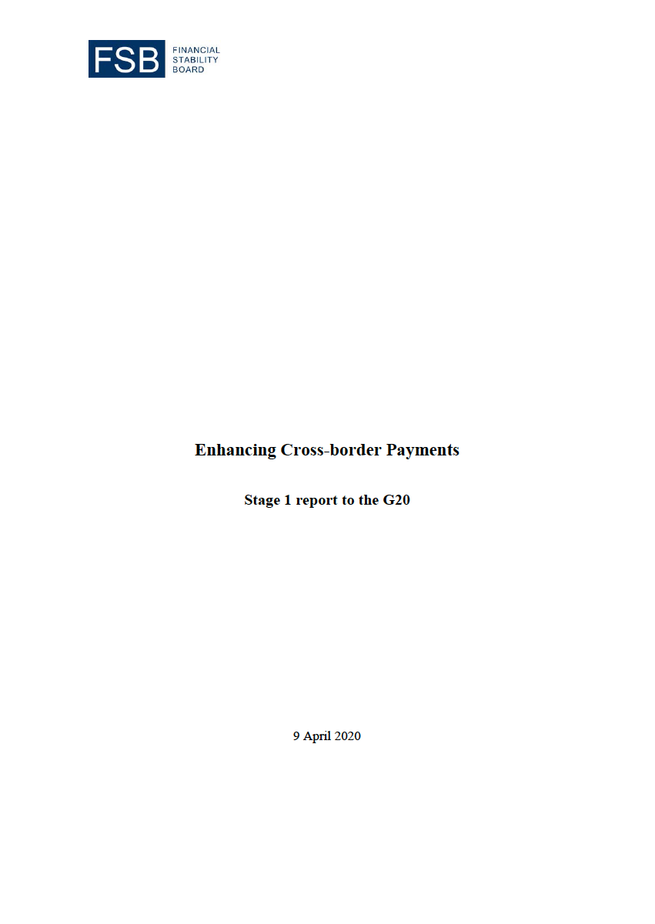
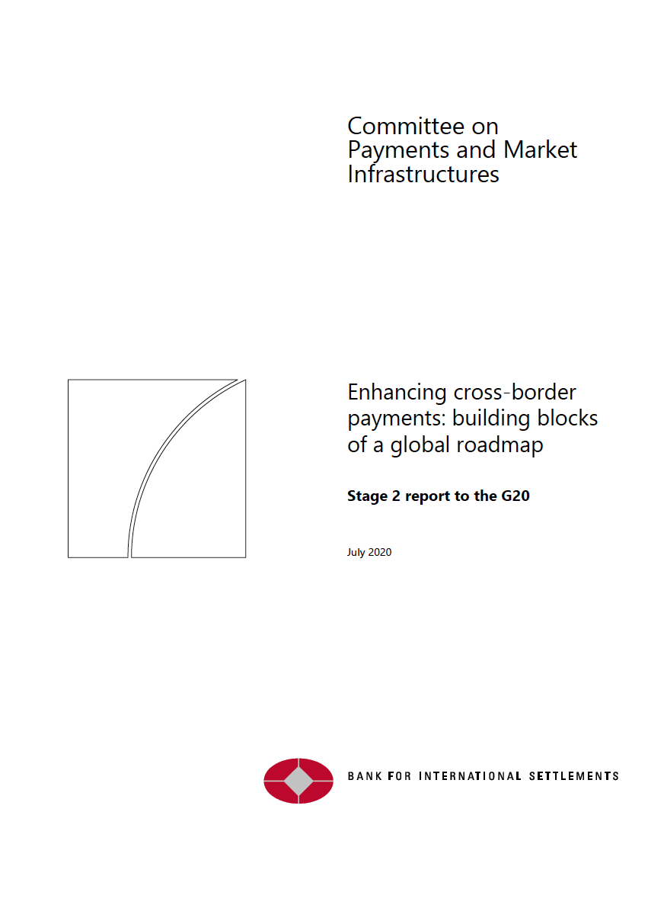
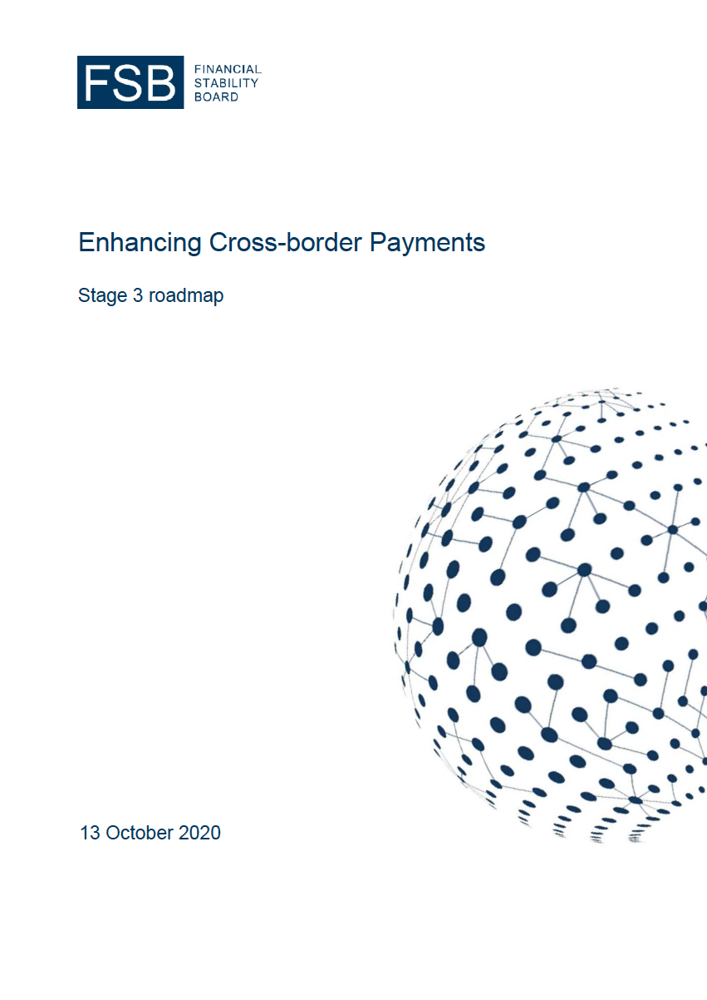
G20 Reports on Cross-Border Payments

Slide 11
G20 has focused on Cross-Border payments
G20 has made cross-border payments a priority.
Cross-border face challenges of high costs, low speed, limited access and insufficient transparency.
Enhancing cross-border payments requires addressing frictions in existing cross-border payment processes.
A number of public sector initiatives have sought to address these challenges and frictions by enhancing existing payment arrangements.
Financial innovation is creating opportunities to make payments more efficient.
Technological innovation could build on existing cross-border and domestic payment arrangements or take the form of new structures and ecosystems.

Slide 12
G20 has asked FSB to coordinate a 3 Stage process
Goal: Develop a roadmap to enhance cross-border payments.
Stage 1: Assessment
Review of existing practices.
Stage 2: Building Blocks
CPMI is leading the work on creating building blocks of a response to improve the current global cross-border payment arrangements.
Stage 3: Roadmap
FSB will coordinate, with CPMI, the development of a roadmap.
Financial Stability Board (FSB)
https://www.fsb.org/about/
The Financial Stability Board (FSB) coordinates at the international level the work of national financial authorities and international standard-setting bodies in order to develop and promote the implementation of effective regulatory, supervisory and other financial sector policies.
Committee of Payment Market Infrastructure (CPMI)
https://www.bis.org/cpmi/about.htm
The Committee on Payments and Market Infrastructures (CPMI) promotes the safety and efficiency of payment, clearing, settlement and related arrangements, thereby supporting financial stability and the wider economy.

Slide 13
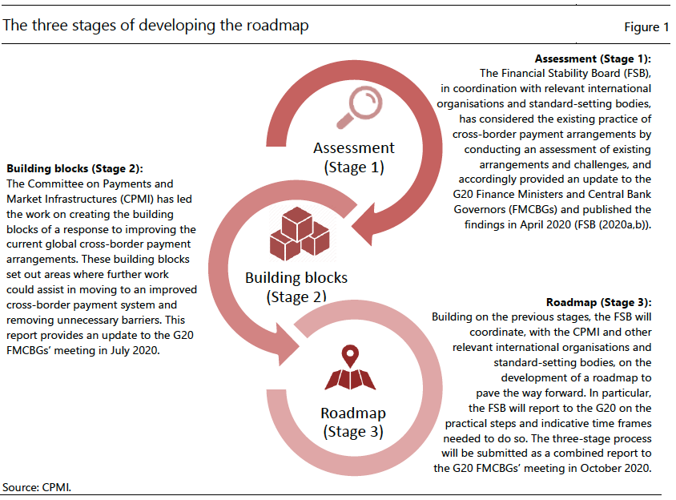
The 3 Stages of Developing the Roadmap
Stage 1:
Complete April 2020
Stage 2:
Complete July 2020
Stage 3:
Complete Oct. 2020

Slide 14
Stages of the project
Stage 1 – Assessment
The FSB … has considered the existing practice of cross-border payment arrangements.
Stage 2 – Building Blocks
CPMI is leading the work on creating building blocks of a response to improve the current global cross-border payment arrangements.
Stage 3 – Roadmap
The FSB will coordinate the development of a roadmap to pave the way forward. In particular, the FSB will report to the G20 on practical steps and indicative timeframes needed to do so.

Slide 15
FSB Initial Stage 1 Issues: Part 1
Operational improvement of payment infrastructures
How can the public and private sectors help to catalyze improvements in technology that help to better satisfy user needs?
Are there initiatives that public authorities could take to enhance key payment infrastructures (cf. real-time gross settlement systems, automated clearing houses, fast payment systems), including to enhance interoperability?
Are there areas where operational improvements can reduce the burden of maintaining liquidity in multiple currencies while meeting prudential liquidity requirements?
Could operational improvements reduce the length of payment chains and, as a result, reduce complexities and risks?

Slide 16
FSB Initial Stage 1 issues: Part 2
Standardization of data and market practice
What steps could the public or private sector take to increase overlaps in operating hours across payment systems in different time zones?
What steps could the public or private sector take to increase the use of standard message format protocols or other mechanisms to ensure interoperability?
What other steps could be taken to address and handle other operational aspects such as data quality, transparency of fees and status of processing, etc.?

Slide 17
FSB Initial Stage 1 issues: Part 3
Legal, regulatory and oversight framework
Which initiatives could be taken to improve the efficiency and reduce costs of AML/CFT and other compliance processes without compromising on the quality of compliance and to ensure adequate oversight?
This could include facilitating improved customer due diligence mechanisms for AML/CFT, greater use of the Legal Entity Identifier (LEI) for firms and digital IDs for individuals and stronger regulatory frameworks that reduce unnecessary barriers to cross-border data sharing when implementing the FATF standards and other regulatory and supervisory requirements.
What further steps in cross-border cooperation in regulation, supervision or oversight could help to reduce frictions?
What further steps can authorities take to enable appropriate access to cross-border payment services?

Slide 18
FSB Initial Stage 1 issues: Part 4
Progress monitoring and information sharing
What data would it be useful to collect going forward to enhance understanding and monitoring of cross-border trends and costs (while taking account of the need to avoid undue burden on firms from data collection)?
What steps can be taken to share good practices in areas such as regulation/supervision/oversight?
How can authorities share experiences in facilitating FinTech development while maintaining a sound financial system and a level playing field?
Are there opportunities for providing technical assistance to improve jurisdictions’ supervisory and regulatory frameworks and thereby enhancing their ability to access cross-border payment markets?

Slide 19
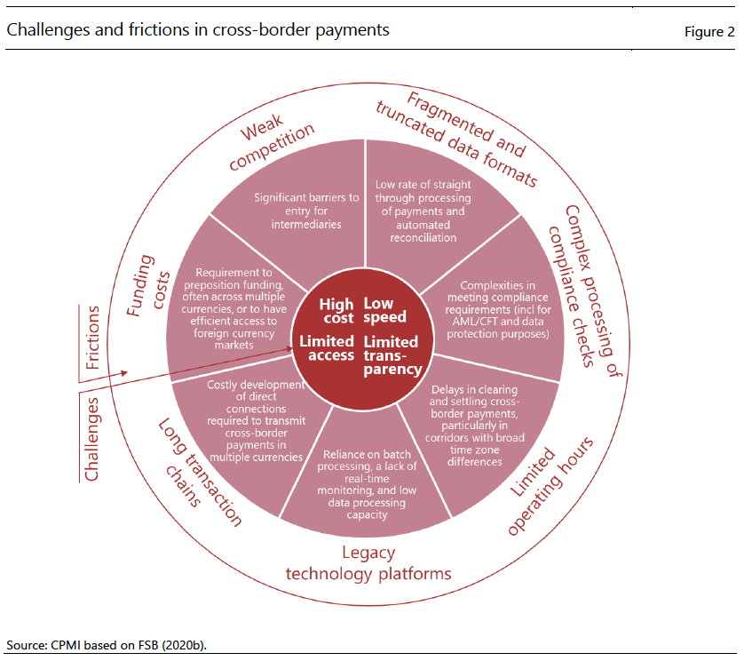
Stage 2: CPMI’s 4 Challenges and 7 Frictions in Cross-Border
Cross-Border Challenges:
High Cost
Low Speed
Limited Access
Limited Transparency

Slide 20
Frictions in cross-border payments
Weak Competition
Significant barriers to entry for intermediaries
Fragmented and truncated data formats
Low rate of straight-through processing
Complex processing of compliance checks
Complexities in meeting compliance requirements
Limited operating hours
Delays in clearing and settlement particularly over many time zones
Legacy technology platforms
Reliance on batch processing and low data processing capacity
Long transaction chains
Direct connections required for cross-border in multiple currencies
Funding costs
Liquidity to pre-position funding and access to foreign currency markets

Slide 21
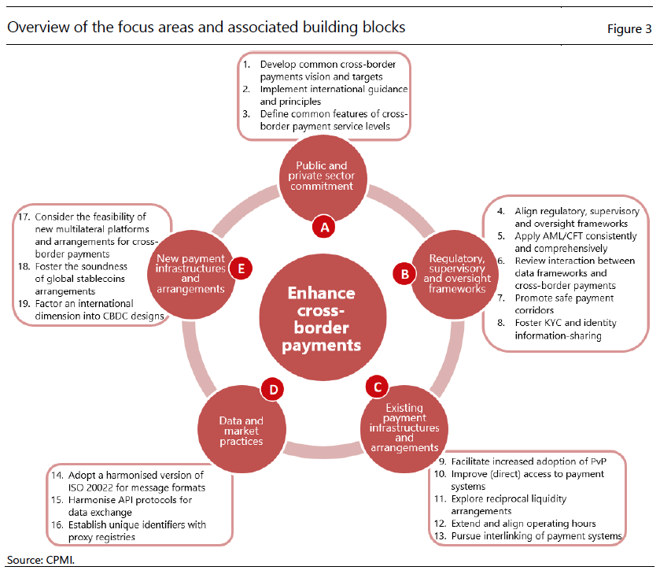
Stage 2: Focus areas and Building Blocks
Focus Areas:
Public and private sector commitment
Regulatory, supervisory, and oversight frameworks
Existing payment infrastructures and arrangements
Data and market practices
New payment infrastructures and arrangements

Slide 22
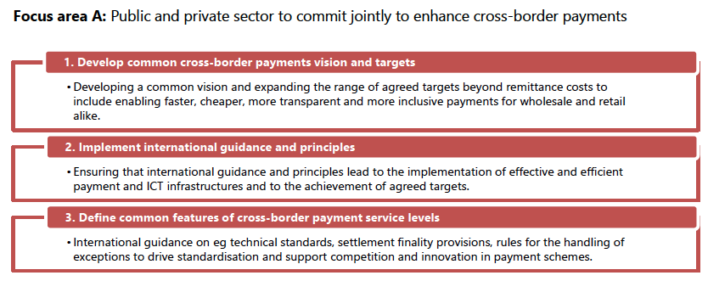
Public and private sector commitment

Slide 23
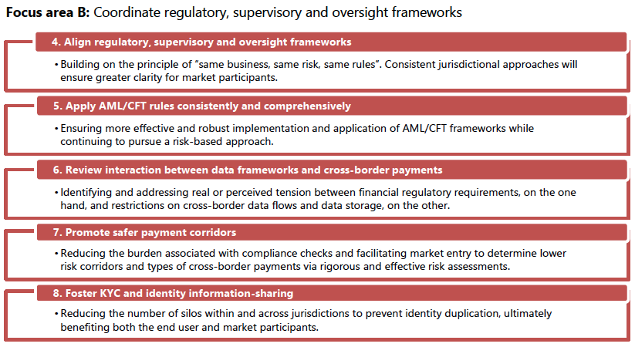
Regulatory, supervisory, and oversight frameworks

Slide 24
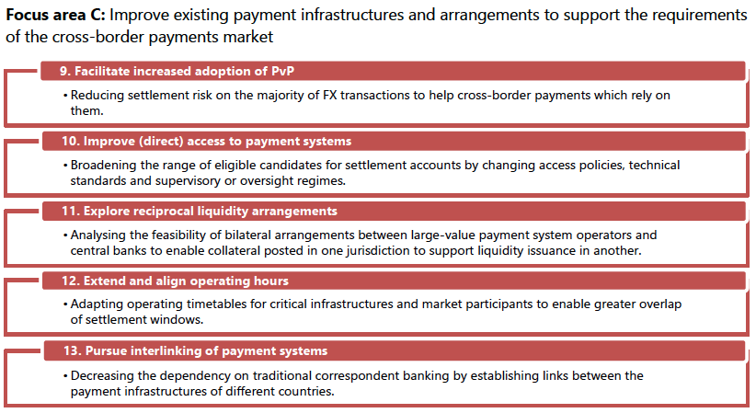
Existing payment infrastructures and arrangements

Slide 25
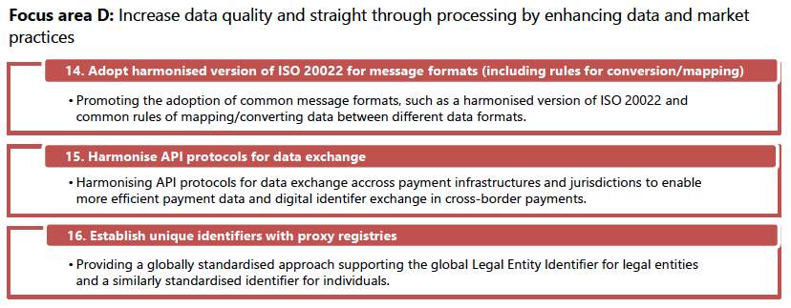
Data and market practices

Slide 26
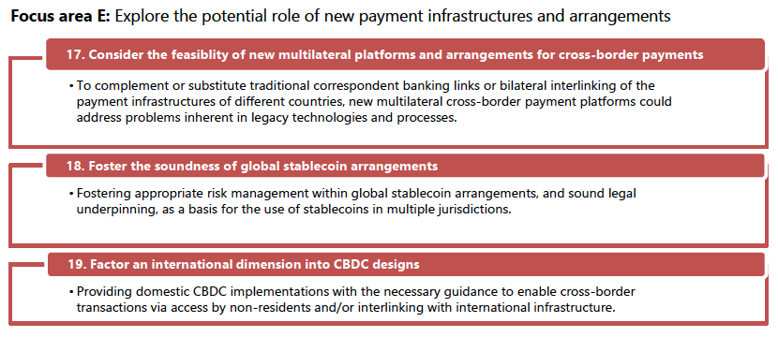
New payment infrastructures and arrangements

Slide 27
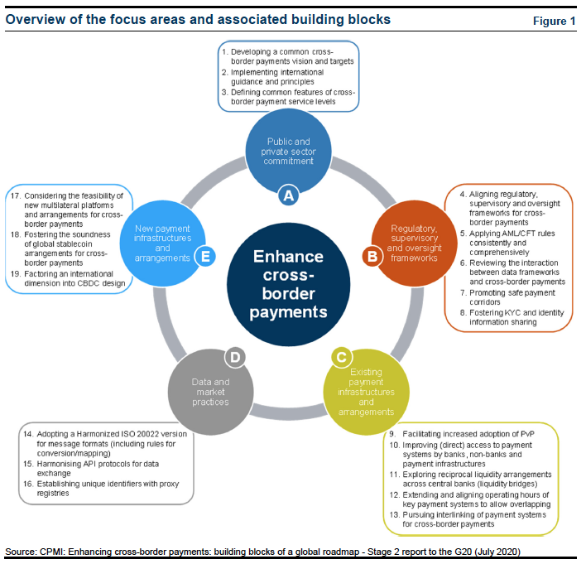
Stage 3: Roadmap
Focus Areas:
Public and private sector commitment
Regulatory, supervisory, and oversight frameworks
Existing payment infrastructures and arrangements
Data and market practices
New payment infrastructures and arrangements

Slide 28
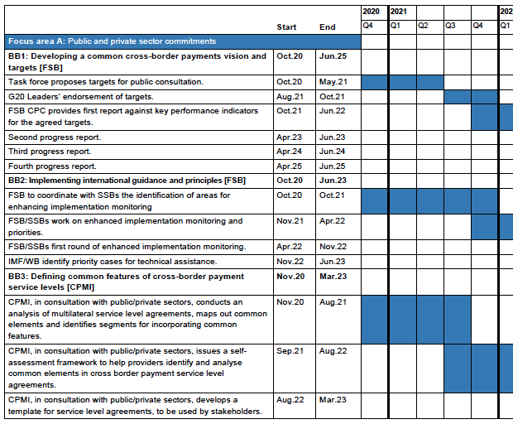
Focus Area A: Public and private sector commitments
Building Blocks:
Developing a common cross-border payments vision and targets
Implementing international guidance and principles
Defining Common Features of Cross-Border Payment Service Levels

Slide 29
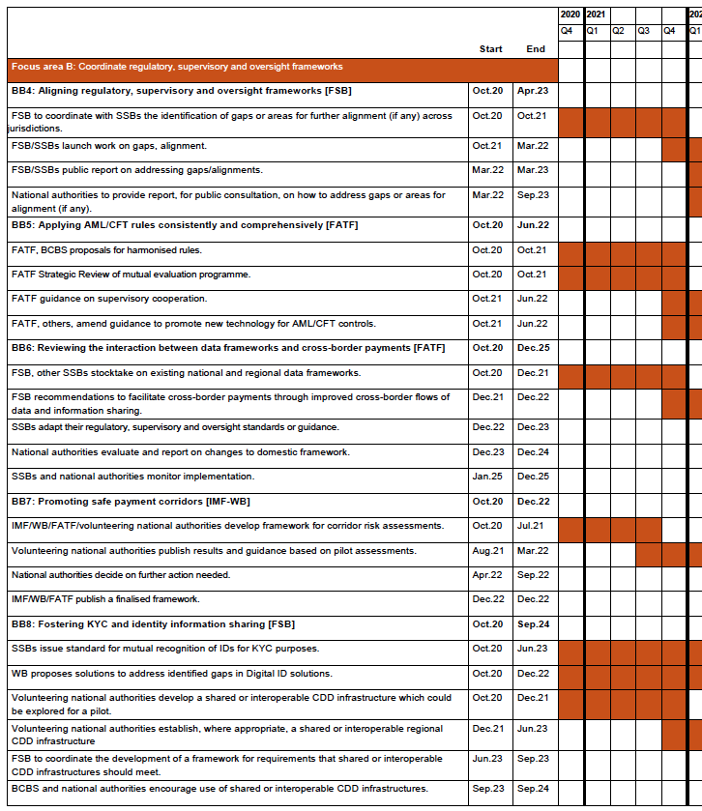
Focus Area B: Regulatory, supervisory, and oversight frameworks
Building Blocks:
Aligning regulatory, supervisory and oversight frameworks for cross-border payments
Applying AML/CFT rules consistently and comprehensively
Reviewing the interaction between data frameworks and cross-border payments
Promoting safe payment corridors
Fostering KYC and identity information sharing

Slide 30
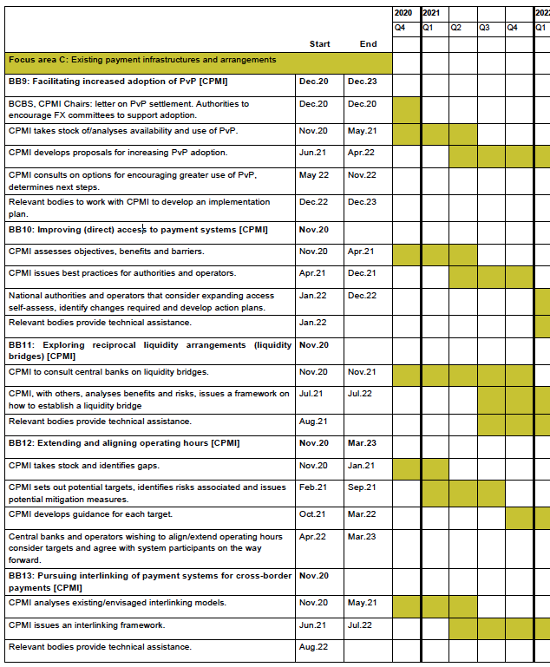
Focus Area C: Existing payment infrastructures and arrangements
Building Blocks:
Facilitating increased adoption of PvP
Improving (direct) access to payment systems by banks, non-banks
Exploring reciprocal liquidity arrangements across central banks (liquidity bridges)
Extending and aligning operating hours of key payment systems to allow overlapping
Pursuing interlinking of payment systems for cross-border payments

Slide 31
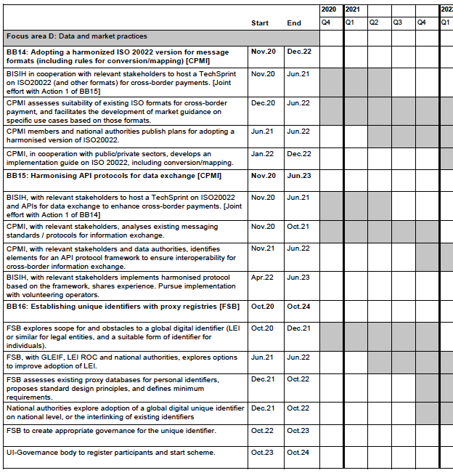
Focus Area D: Data and market practices
Building Blocks:
Adopting a Harmonized ISO 20022 version for message formats
Harmonizing API protocols for data exchange
Establishing unique identifiers with proxy registries

Slide 32
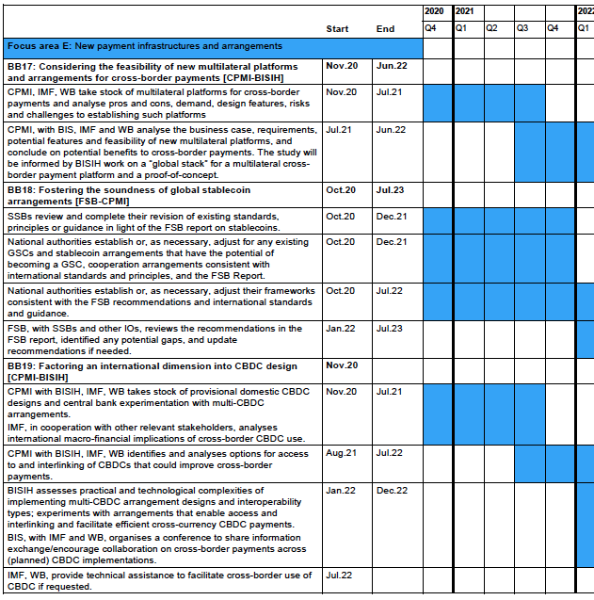
Focus Area E: New payment infrastructures and arrangements
Building Blocks:
Considering the feasibility of new multilateral platforms and arrangements for cross-border payments
Fostering the soundness of global stablecoin arrangements for cross-border payments
Factoring an international dimension into CBDC design

Slide 33
Conclusions
Long-term planning for Mojaloop requires visibility to policy.
International institutions are defining requirements and work to address new payments (stablecoins, virtual assets).
New use cases for cross-border transactions (same currency or different currency) may require advance planning to comply.
CBDCs are seen as intersecting with payment networks.
Although regulations normally lag behind technology, there are some cases where there is fair warning.

Slide 34
Reading List
FATF Report to G20 on Stablecoins
https://www.fatf-gafi.org/publications/fatfgeneral/documents/report-g20-so-called-stablecoins-june-2020.html
FSB Stage 1 Report to the G20
https://www.fsb.org/2020/04/enhancing-cross-border-payments-stage-1-report-to-the-g20/
FSB Stage 1 Technical Background Report
https://www.fsb.org/2020/04/enhancing-cross-border-payments-stage-1-report-to-the-g20/
CPMI Stage 2 Report to the G20
https://www.bis.org/cpmi/publ/d193.htm
CPMI Stage 2 Technical Background Report
https://www.bis.org/cpmi/publ/d194.htm
FSB Stage 3 Report to the G20
https://www.fsb.org/2020/10/enhancing-cross-border-payments-stage-3-roadmap/

Slide 35
Thank You!
David Mangini
david.mangini@gioridigital.com

